Slide 1
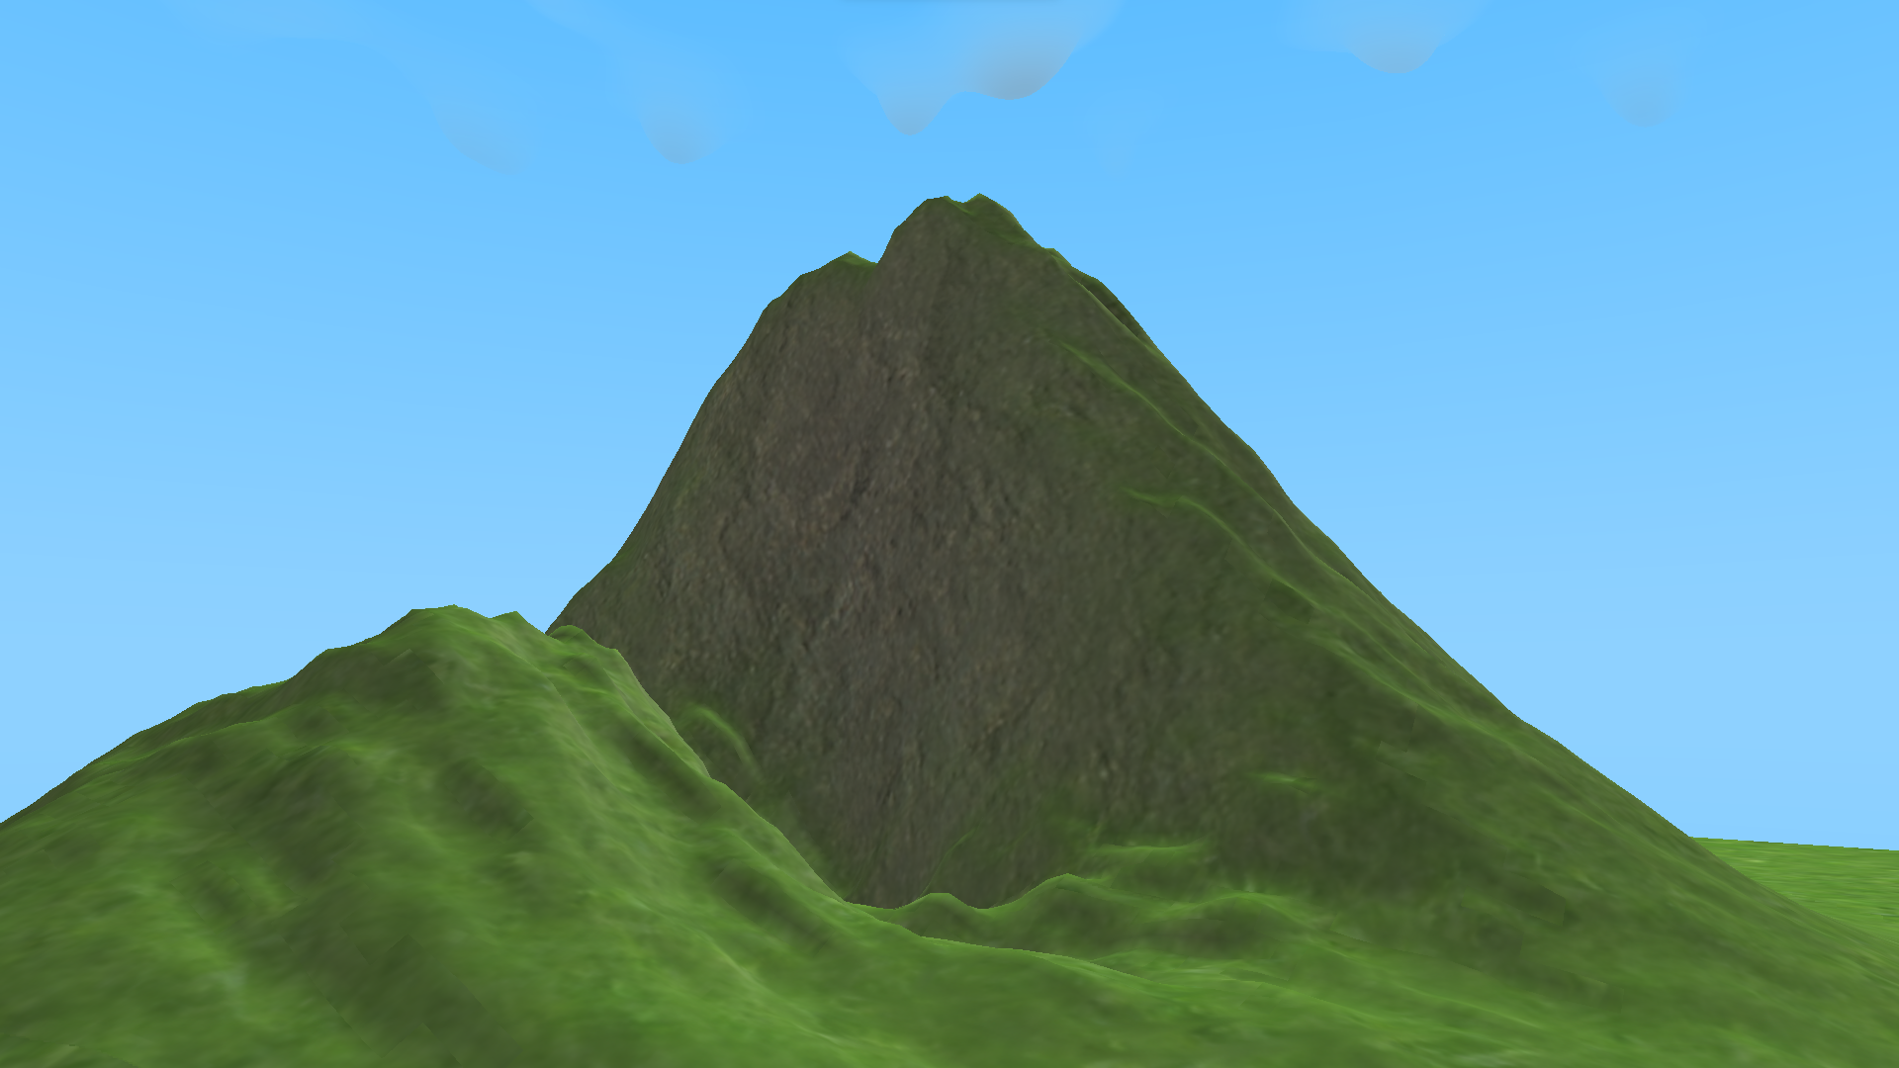
Pycraft
Play
Credits
Settings
Achievements
Character Customisation

Slide 2
Pycraft
Play
Credits
Settings
Achievements
Character Customisation

Slide 3

Pycraft
Play
Credits
Settings
Achievements
Character Customisation

Slide 4
Pycraft
Play
Credits
Settings
Achievements
Character Customisation

Slide 5

Pycraft

Slide 6



Slide 7

Pycraft

Slide 8

Pycraft

Slide 11


Slide 12


Slide 13


Slide 14


Slide 15
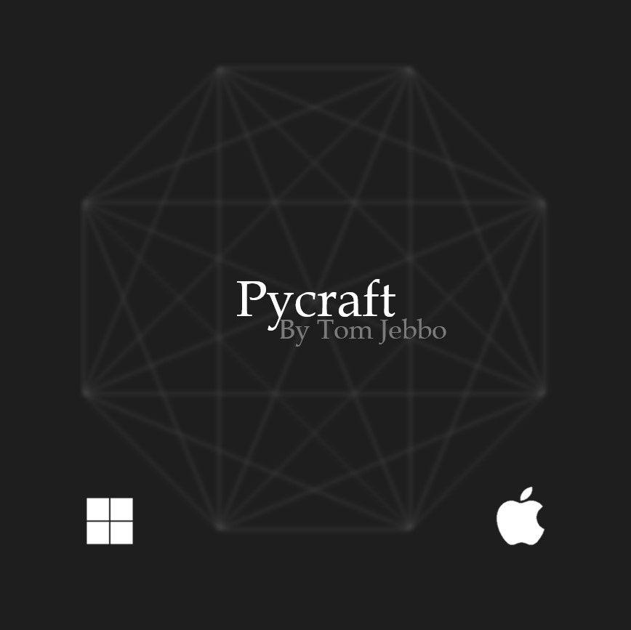

Slide 16


Slide 17


Slide 18


Slide 19


Slide 20


